Slide 1
EXST-7034 REGRESSION ANALYSIS
Group 5:
Chuqi Guo
Joaquin Rodriguez
Justin Guice
Mohamed Ohaiba
Vansh Vyas

Slide 2
Models to Predict Incumbent Vote
5 models:
Campbell
Abramowitz
Holbrook
Lockerbie
Fairs
Models comparison

Slide 3
Campbell Model
The model includes Incumbent Vote as function of two predictors:
September Trial Heat: Percentage of support for the in-party candidate in the preference poll conducted by Gallop in early September of the election year.
GDP growth Rate: The second-quarter rate of growth in GDP.
Dataset ranges from the year 1948 – 1996

Slide 4
Dataset for Campbell
Year | IncVote | SepTr | GDPGrR
1948 | 52.32 | 45.61 | 0.91
1952 | 44.59 | 42.11 | 0.27
1956 | 57.75 | 55.91 | 0.64
1960 | 49.92 | 50.54 | -0.26
1964 | 61.34 | 69.15 | 0.81
1968 | 49.6 | 41.89 | 1.63
1972 | 61.79 | 62.89 | 1.73
1976 | 48.95 | 40 | 1.17
1980 | 44.7 | 48.72 | -2.43
1984 | 59.17 | 60.22 | 1.79
1988 | 53.9 | 54.44 | 0.79
1992 | 46.55 | 41.94 | 0.35
1996 | 54.74 | 60.67 | 1.04

Slide 5
Campbell - Modeling
Modeling:
Backwards & stepwise: Full model
All possible models regression: Full model (Chosen Model)
Number in Model | R-Square | Adjusted R-Square | C(p) | MSE | PRESS | Variables in Model
1 | 0.7587 | 0.7368 | 22.0361 | 9.41820 | 137.06094 | STH
1 | 0.3470 | 0.2877 | 74.9943 | 25.48890 | 392.42663 | GDPgr
2 | 0.9223 | 0.9067 | 3.0000 | 3.33806 | 48.62267 | STH GDPgr

Slide 6
Parameter Estimates
Variable | DF | Parameter Estimate | Standard Error | t Value | Pr > |t| | Standardized Estimate | Variance Inflation
Intercept | 1 | 25.75387 | 2.95317 | 8.72 | <.0001 | 0 | 0
STH | 1 | 0.49173 | 0.05716 | 8.60 | <.0001 | 0.77819 | 1.05273
GDPgr | 1 | 2.25706 | 0.49211 | 4.59 | 0.0010 | 0.41492 | 1.05273
Final Regression Model Equation:
25.75387 + 0.49173*(September Trial Heat) + 2.25706 (GDP growth rate)

Slide 7
Campbell - Diagnostics
VIF were all less than 10, therefore no multicollinearity problem.
Durbin-Watson’s D was not significant and no autocorrelation
Residuals were normally distributed as tested by Shapiro-Wilk test for normality with p-value=0.634.
Durbin-Watson D | 2.149
Pr < DW | 0.7034
Pr > DW | 0.2966
Number of Observations | 13
1st Order Autocorrelation | -0.292

Slide 8
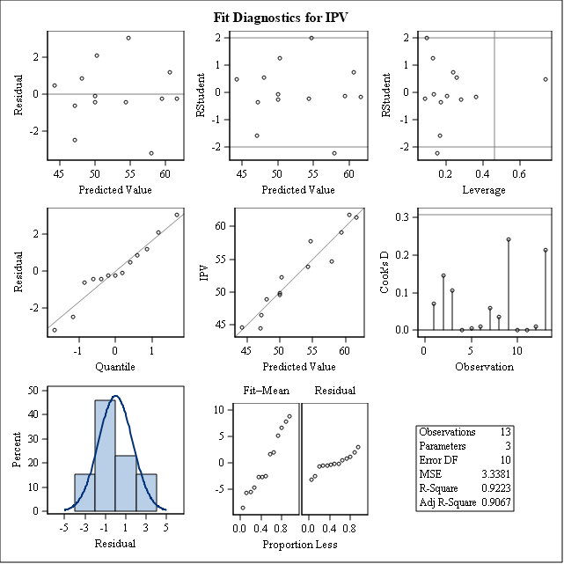
Campbell - Residuals
Observation 9 is an outlier as it has high high hat diagonal (hii>2p/n) and high Cook’s D (<1). Therefore, observation is not influential.
PRESS (with all obs.)= 48.62267

Slide 9
Campbell – Prediction & Forecasting
Removing last observation at predicted the Incumbent votes for the year 1996.
1996: Actual IV = 54.74%, Predicted IV= 58.4990% Prediction CI (54.7207, 62.2855)
PRESS(2 deleted observations)=33.46032
With real data of September Trial Heat and GDP growth rate for the 2000 and 2004 elections added to the model we predicted Incumbent Votes. The regression equation worked well for prediction.
2000: Actual IV = 48.4%, Predicted IV= 51.5333% Prediction CI (47.1339, 55.9328)
PRESS(2 deleted observations)=48.62267

Slide 10
Abramowitz Dataset
In 1998, Alan Abramowitz devised time-for-change model
Models Incumbent Vote as function of approval rating and first two quarters of annual GDP growth rate
Dataset ranges from 1948 – 1996
Independent Random Variables:
Term: (Indicator: 1: ≥8 years+ in WH, 0 otherwise)
Approval Rating: Current president popularity early June
GDP Growth Rate: 1st two quarters

Slide 11
Abramowitz - Modeling
Modeling:
Backwards & stepwise: Full model
All possible models regression: Full model
Number in Model | R-Square | Adjusted R-Square | C(p) | MSE | PRESS | Variables in Model
1 | 0.7563 | 0.7342 | 17.5495 | 9.50204 | 134.1103 | Popular
1 | 0.4423 | 0.3916 | 51.7680 | 21.74875 | 360.1404 | GDPgrowth
1 | 0.3868 | 0.3311 | 57.8075 | 23.91030 | 373.9996 | Term
2 | 0.8230 | 0.7876 | 12.2879 | 7.59341 | 137.9872 | Term GDPgrowth
2 | 0.8133 | 0.7760 | 13.3405 | 8.00782 | 157.2665 | Term Popular
2 | 0.8044 | 0.7653 | 14.3112 | 8.38996 | 246.9126 | Popular GDPgrowth
3 | 0.9174 | 0.8899 | 4.0000 | 3.93688 | 102.2257 | Term Popular GDPgrowth

Slide 12
Abramowitz - Diagnostics
VIF were all less than 10
Durbin-Watson’s D was not significant
Residuals were normally distributed
Final regression equation:
Incumbent Vote = 45.05936 – 4.69089(Term) + 0.17855(Popularity)
+ 2.13891(GDPgrowth)

Slide 13
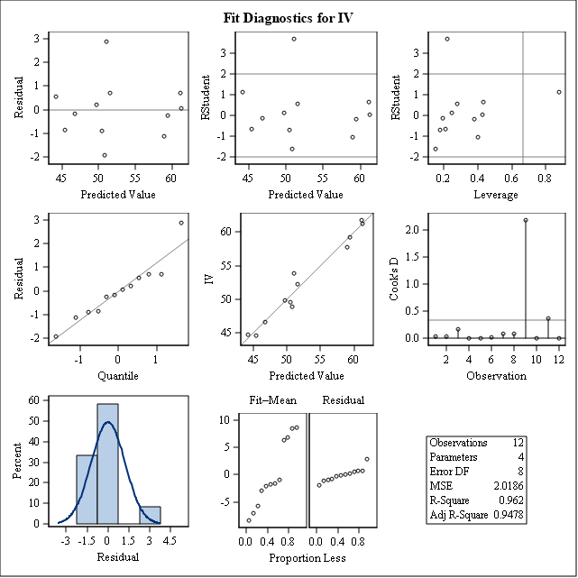
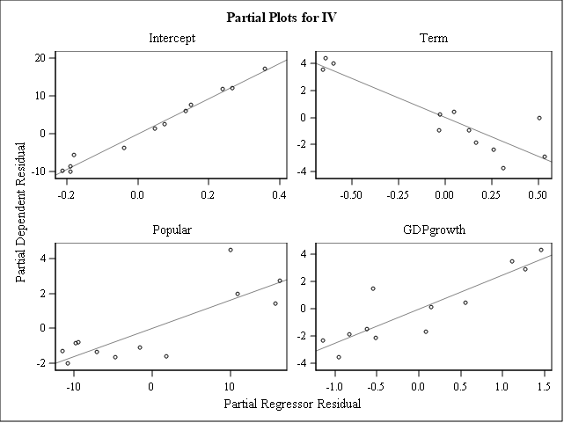
Abramowitz - Partial Plots

Slide 14
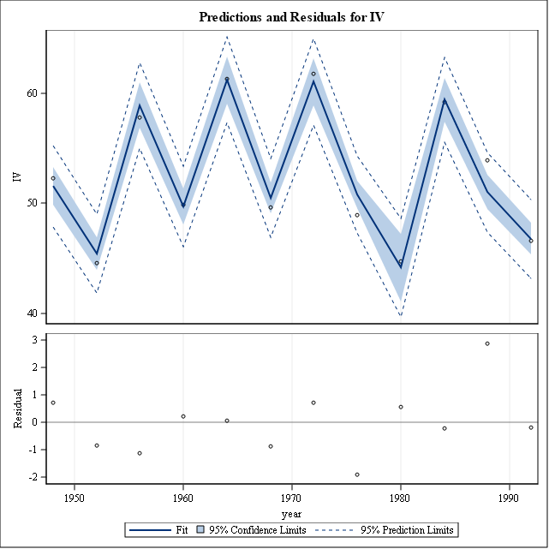
Abramowitz - Prediction

Slide 15
Abramowitz - Prediction
Forecasting:
“Essentially, all models are wrong, but some are useful.” – George Box
Tested regression equation with additional data:
2000 | Actual IV = 50.3% | Prediction: 54.08% CIp: (48.8883, 59.2632)
2004 | Actual IV = 51.2% | Prediction: 54.66% Clp: (49.7814, 59.5460)

Slide 16
Holbrook
The Holbrook model assumes that the predictors of incumbent vote are:
Presidential popularity: average percentage of the public who said that they approved of the way the president is handling his job.
Personal finance: measure of retrospective personal finances based on responses to the Survey of Consumers.
Tenure in office: binary variable coded 1 for presidential candidates whose party has held the White House for two or more terms and 0 for candidates whose party has held the White House for one term.

Slide 17
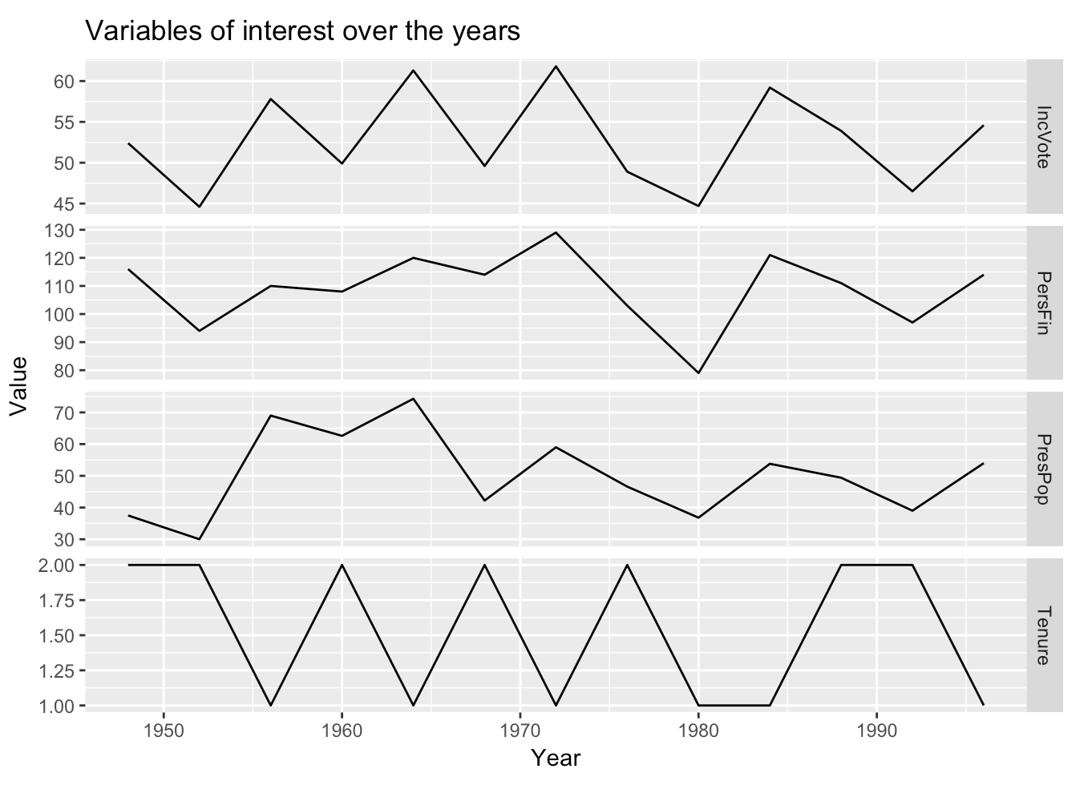
Holbrook - Exploratory Analysis

Slide 18
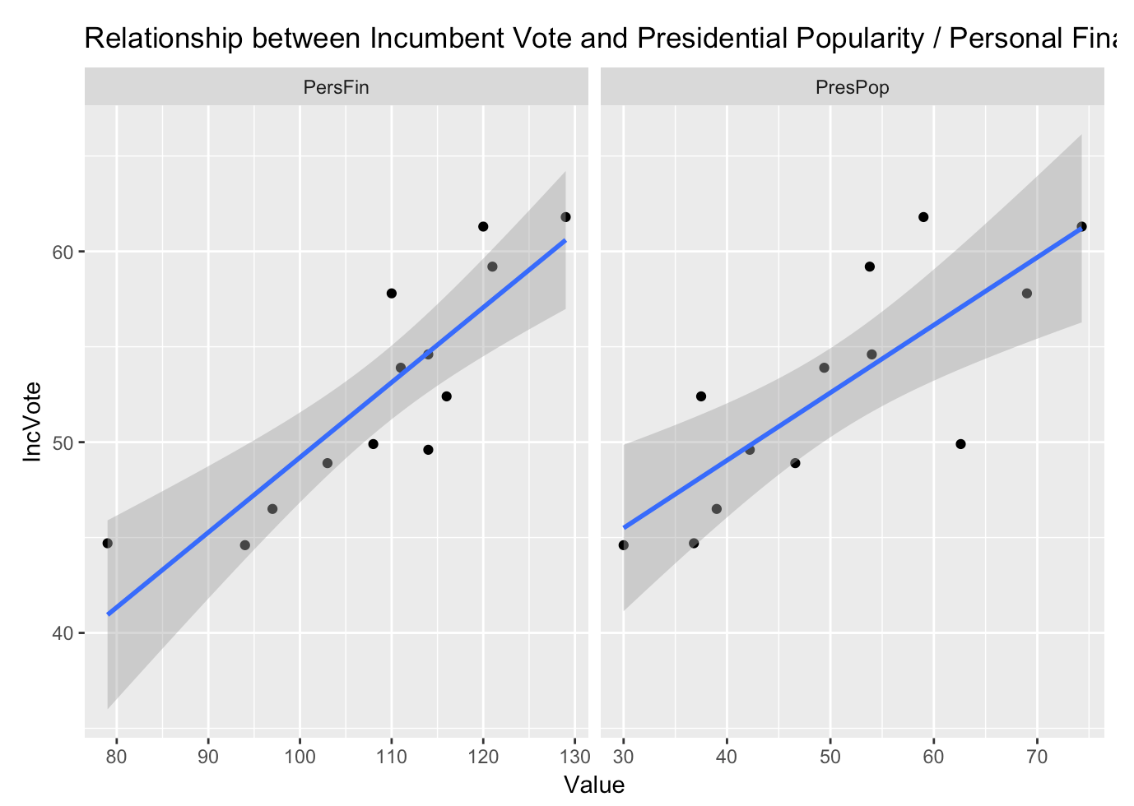
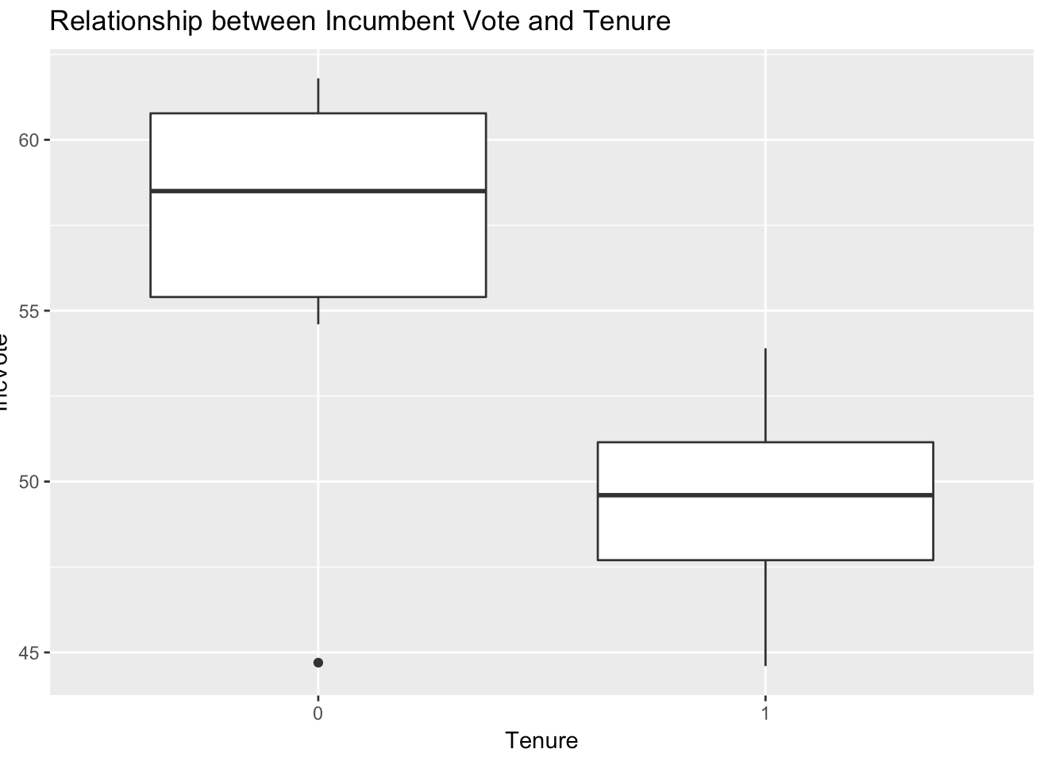
Holbrook – Exploratory Analysis

Slide 19
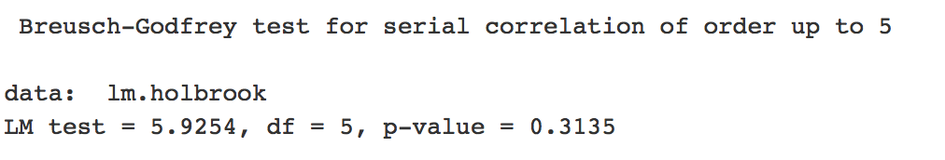
Holbrook - Correlation
The test indicates that there is no autocorrelation of the error terms, therefore the assumption of independence of the observations is satisfied
The incumbent vote is highly correlated to the presidential popularity and personal finances measures
 | IncVote | PresPop | PersFin
IncVote | 1
PresPop | 0.79 | 1
PersFin | 0.86 | 0.59 | 1

Slide 20
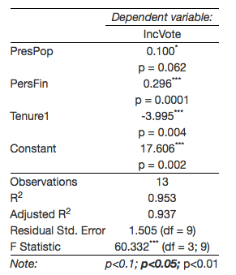
Holbrook - Model

Slide 21
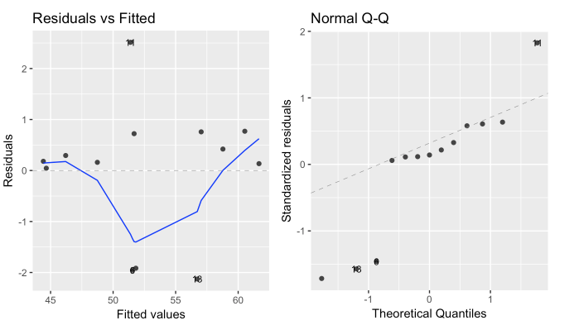
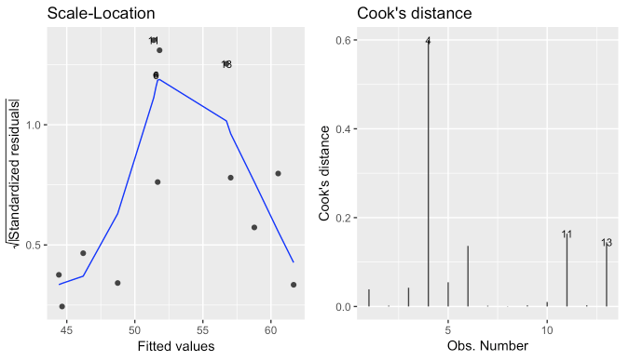
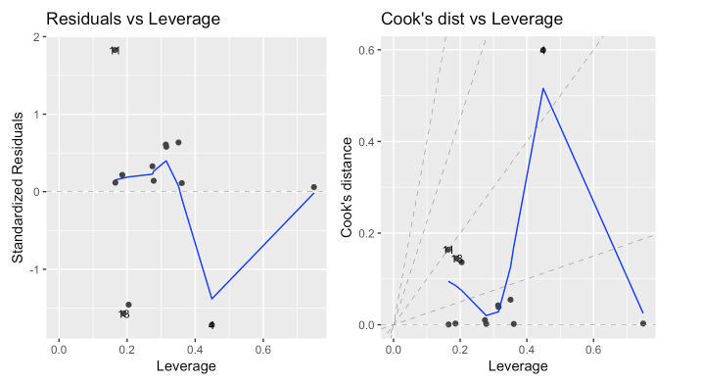
Holbrook - Residuals
Strong violations of model assumptions
One strong outlier

Slide 22
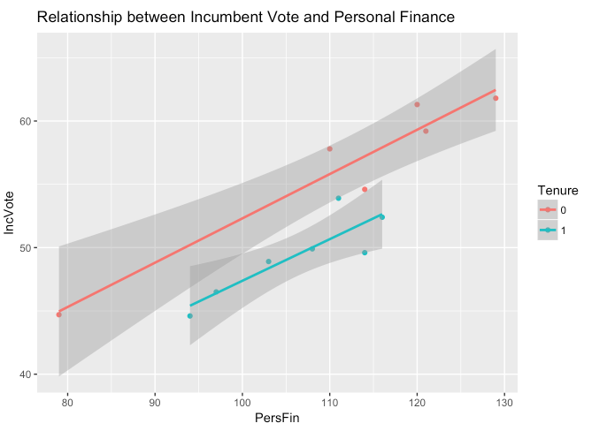
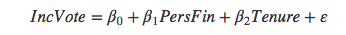
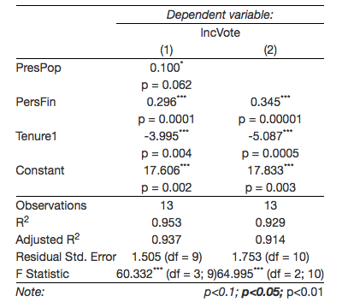
Holbrook – Alternative Model
 | PRESS | SSE
Full Model | 38.46 | 20.37
Reduced Model | 47.03 | 30.72

Slide 23
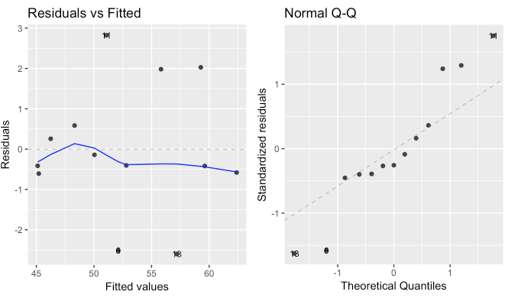
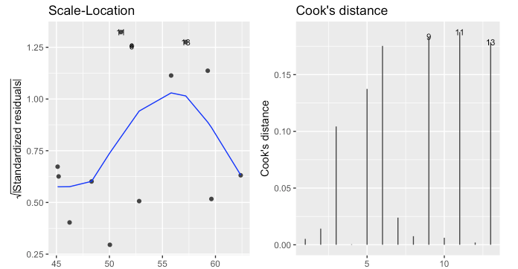
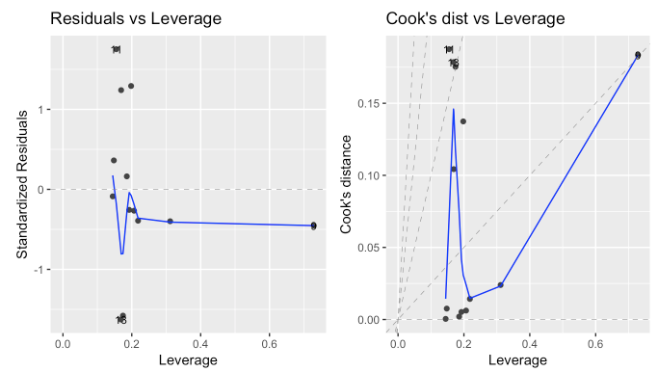
Holbrook – Alternative Model Residuals
Improvement on model assumptions
One outlier
No influential observations

Slide 24
Lockerbie Data Description
Year | Incumbent Vote | Disposable Income 1 | Disposable Income 2 | Next Year Better | Tenure
1956 | 57.80 | 1.60 | 3.70 | 36.00 | 4
1960 | 49.90 | 1.65 | 2.26 | 35.00 | 8
1964 | 61.30 | 4.74 | 1.78 | 37.00 | 4
1968 | 49.60 | 2.91 | 3.31 | 33.00 | 8
1972 | 61.79 | 1.61 | 2.39 | 38.00 | 4
1976 | 48.90 | 2.03 | 0.68 | 32.00 | 8
1980 | 44.70 | -1.26 | 1.59 | 26.00 | 4
1984 | 59.20 | 2.67 | 1.67 | 37.33 | 4
1988 | 53.90 | 1.73 | -0.05 | 36.33 | 8
1992 | 46.50 | 2.10 | -1.03 | 36.33 | 12
1996 | 54.74 | 2.07 | 2.33 | 35.67 | 4
Dependent Variable: Incumbent Vote
Independent Variables: Disposable Income 1, Disposable Income 2, Next Year Better and Tenure
n=11,
Data Rang: 1956-1996

Slide 25
Lockerbie Model
All possible regressions for IV to DI1 DI2 NYB Tenure
Number in Model | R-Square | C(p) | MSE | Variables in Model
1 | 0.5438 | 52.2201 | 18.14817 | NYB
1 | 0.3875 | 72.5107 | 24.36627 | Tenure
1 | 0.2936 | 84.6908 | 28.09889 | DI1
1 | 0.1417 | 104.4172 | 34.14409 | DI2
2 | 0.9418 | 2.5610 | 2.60674 | NYB Tenure | PRESS: 37.37666
2 | 0.7257 | 30.6068 | 12.27578 | DI1 Tenure
2 | 0.6921 | 34.9709 | 13.78035 | DI2 NYB
2 | 0.5471 | 53.7865 | 20.26717 | DI1 NYB
2 | 0.4161 | 70.7863 | 26.12803 | DI1 DI2
2 | 0.3879 | 74.4590 | 27.39421 | DI2 Tenure
3 | 0.9527 | 3.1391 | 2.41887 | DI1 NYB Tenure | PRESS: 34.21184
3 | 0.9420 | 4.5298 | 2.96684 | DI2 NYB Tenure
3 | 0.7332 | 31.6280 | 13.64379 | DI1 DI2 Tenure
3 | 0.6928 | 36.8701 | 15.70925 | DI1 DI2 NYB
4 | 0.9538 | 5.0000 | 2.75807 | DI1 DI2 NYB Tenure | PRESS: 38.66372

Slide 26
Lockerbie Model
Modeling: Backward selection and stepwise selection
Results indicate that a simplified model is preferred:
Incumbent Vote_hat=16.64592 + 1.30288 Next Year Better-1.37258Tenure
Diagnostics:
Shapiro-Wilk Test indicates that the data is normally distributed.
VIF and condition index indicate no multicollinearity problem.
Durbin-Watson D shows no autocorrelation.

Slide 27
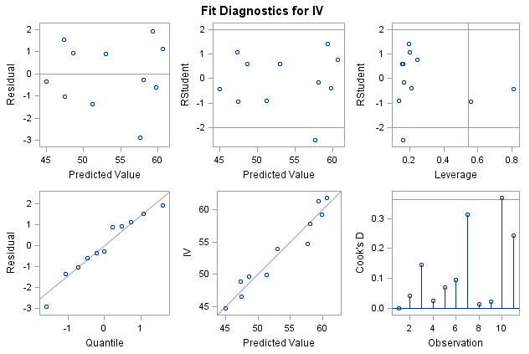
Lockerbie Model
Outlier and influential points
Output Statistics
Obs | Cook’s D | RStudent | Hat Diag H | Cov Ratio | DFFITS | DFBETAS
 |  |  |  |  |  | Intercept | NYB | Tenure
1 | 0.002 | -0.1649 | 0.1671 | 1.7714 | -0.0739 | 0.0055 | -0.0208 | 0.0456
2 | 0.043 | -0.8987 | 0.1349 | 1.2435 | -0.3549 | 0.0331 | -0.0167 | -0.2018
3 | 0.147 | 1.4224 | 0.1969 | 0.8678 | 0.7043 | -0.1907 | 0.3293 | -0.4019
4 | 0.026 | 0.6106 | 0.1627 | 1.5258 | 0.2692 | 0.0971 | -0.1119 | 0.1408
5 | 0.069 | 0.7815 | 0.2438 | 1.5359 | 0.4438 | -0.1888 | 0.2696 | -0.2285
6 | 0.097 | 1.0809 | 0.2023 | 1.1777 | 0.5443 | 0.2850 | -0.3149 | 0.2566
7 | 0.312 | -0.4452 | 0.8097 | 7.2157 | -0.9184 | -0.8869 | 0.8266 | 0.2467
8 | 0.015 | -0.3903 | 0.2105 | 1.7725 | -0.2015 | 0.0658 | -0.1045 | 0.1114
9 | 0.022 | 0.5812 | 0.1543 | 1.5323 | 0.2483 | -0.0973 | 0.0887 | 0.1311
10 | 0.369 | -0.9303 | 0.5567 | 2.3736 | -1.0426 | 0.3464 | -0.1888 | -0.9326
11 | 0.244 | -2.5274 | 0.1610 | 0.2543 | -1.1071 | 0.0016 | -0.2331 | 0.6948

Slide 28
Lockerbie Model
Modeling fitting
Take out data point from the dataset to test model fitting:
Obs 9, 1988 Actual IV=53.90, Predicted IV=52.8345,
95% CI predicted (48.4998, 57.1693)

Slide 29
Fair’s Model:
$Incumbent vote share=62.6+0.496 growth rate−1.18 inflation$
$−6.78 duratioin value−4.64 party+11.0 war$
Fair used his model to predict the vote share of the incumbent party in the 2000 presidential election.
The growth rate was 2.2%, inflation was at 1.7%, the duration variable has value 1 because the Democrats have been in power for two consecutive terms, the war indicator is zero, and lastly, the party indicator 1 for Democrat.
The model predicted 50.306% Incumbent vote share for Gore

Slide 30
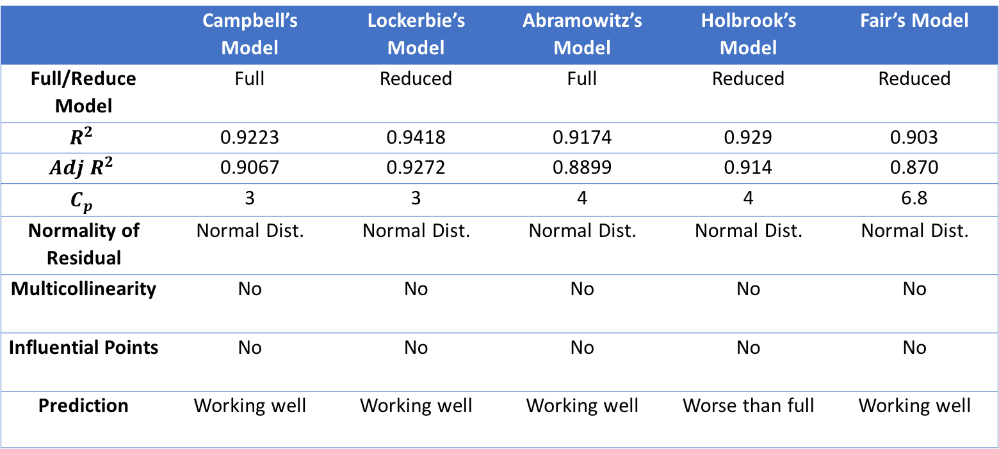
Conclusions - Model Comparison
 | Campbell’s Model | Lockerbie’s Model | Abramowitz’s Model | Holbrook’s Model | Fair’s Model
Full/Reduce Model | Full | Reduced | Full | Reduced | Reduced
$$R^{2}$$ | 0.9223 | 0.9418 | 0.9174 | 0.929 | 0.903
$$Adj R^{2}$$ | 0.9067 | 0.9272 | 0.8899 | 0.914 | 0.870
$$C_{p}$$ | 3 | 3 | 4 | 4 | 6.8
Normality of Residual | Normal Dist. | Normal Dist. | Normal Dist. | Normal Dist. | Normal Dist.
Multicollinearity | No | No | No | No | No
Influential Points | No | No | No | No | No
Prediction | Working well | Working well | Working well | Worse than full | Working well

